Slide 1
Chapter : Project Management Concept

Slide 2
Management Spectrum
Effective project management focuses on four aspects of the project known as the 4 P’s:
People - The most important element of a successful project. Key areas for software people - recruiting, selection, performance management, training, compensation, career development, organization & work design, team/culture development.
Product - The software to be built (product objectives, scope, alternative solutions, constraint)
Process - The set of framework activities and software engineering tasks to get the job done (framework activities populated with tasks, milestones, work products, and QA points)
Project - All work required to make the product a reality. (planning, monitoring, controlling)

Slide 3
People
Player of the project:
The Stakeholders
Team leaders
The Software Team
Coordination and Communication Issues.

Slide 4
Stakeholders
Senior managers who define the business issues that often have significant influence on the project.
Project (technical) managers who must plan, motivate, organize, and control the practitioners who do software work.
Practitioners who deliver the technical skills that are necessary to engineer a product or application.
Customers who specify the requirements for the software to be engineered
End-users who interact with the software once it is released for production use.

Slide 5
Team Leaders
MOI model for leadership
Motivation The ability to encourage (by “push or pull”) technical people to produce to their best ability.
Organization The ability to mold existing processes (or invent new ones) that will enable the initial concept to be translated into a final product.
Ideas or Innovation The ability to encourage people to create and feel creative even when they must work within bounds established for a particular software product or application.
Characteristics of effective project managers (problem solving, managerial identity, achievement, influence and team building)

Slide 6

Software Teams
How to lead?
How to organize?
How to collaborate?
How to motivate?
How to create good ideas?

Slide 7
Software Teams
The following factors must be considered when selecting a
software project team structure ...
The difficulty of the problem to be solved
The size of the resultant program(s) in lines of code or function points
The time that the team will stay together (team lifetime)
The degree to which the problem can be modularized
The required quality and reliability of the system to be built
The rigidity (hardness) of the delivery date
The degree of sociability (communication) required for the project

Slide 8
“Organizational Paradigms” for software engineering team
Closed paradigm—
  Structures a team along a traditional hierarchy of authority.
  Such teams can work well when producing software that is quite similar to past efforts.
  So, Less likely to be innovative when working within the closed paradigm.
Random paradigm—
  Structures a team loosely and depends on individual initiative of the team members.
  When innovation or technological breakthrough is required, teams following the random paradigm will excel.
  It struggles when “orderly performance” is required.

Slide 9
Contd.
Open paradigm—
  Structure a team in a manner that achieves some of the controls associated with the closed paradigm but also much of the innovation that occurs when using the random paradigm.
  Open paradigm team structures are well suited to the solution of complex problems but may not perform as efficiently as other teams.
Synchronous paradigm—
  Relies on the natural categorization of a problem and organizes team members to work on pieces of the problem with little active communication among themselves.

Slide 10
Team Coordination & Communication
Characteristics of modern software—
  Scale, - development effort is high
  Uncertainty, - continuing stream of changes
  Interoperability - New software must communicate with existing software
Software engineering team must establish effective methods for coordinating the people who do the work.
To accomplish this, mechanisms for formal and informal communication among team members and between multiple teams must be established.
Formal communication is accomplished through “writing, structured meetings, and other relatively activities.
Informal communication is more personal. Members of a software team share ideas on an ad hoc basis, ask for help as problems arise, and interact with one another on a daily basis.

Slide 11
The Product
The product is consists of two things.
  Software or product scope
  Problem decomposition.

Slide 12
Product Scope
Software Scope: Scope is defined by answering the following questions:
  Context
    How does the software to be built fit into a larger system, product, or business context.
    what constraints are compulsory as a result of the context?
  Information objectives
    What customer-visible data objects are produced as output from the software?
    What data objects are required for input?
  Function and performance
    What function does the software perform to transform input data into output?
    Are any special performance characteristics to be addressed?
Software project scope must be unambiguous and understandable at the management and technical levels.

Slide 13
Problem Decomposition
Sometimes called partitioning or problem elaboration
Decomposition is applied in 2 major areas
  Functionality that must be delivered.
  Process that will be used to deliver it.
Software functions, described in the statement of scope, are evaluated and refined to provide more detail prior to the beginning of estimation
Once scope is defined …
  It is decomposed into part functions
  It is decomposed into user-visible data objects
  or
  It is decomposed into a set of problem classes
Decomposition process continues until all functions or problem classes have been defined
Decomposition will make planning easier.

Slide 14
The Process
Process model chosen must be appropriate for the:
  the customers who have requested the product and the people who will do the work,
  Characteristics of the product itself, and
  Project development environment
Once a process framework has been established
  Determine the degree of thoroughness required
  Define a task set for each software engineering activity
    Task set =
      Software engineering tasks
      Work products
      Quality assurance points
      Milestones

Slide 15
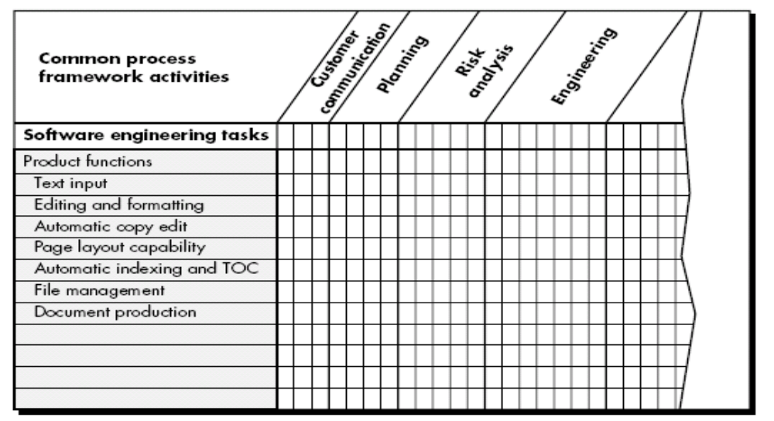
Melding the Product and Process

Slide 16
Melding the Product and Process
Project planning begins with melding the product and the process
Each function to be engineered must pass through the set of framework activities defined for a software organization
Each major product function is listed in the left-hand column.
Framework activities are listed in the top row.
Software engineering work tasks would be entered in the following row.
The job of the project manager is to estimate resource requirements for each matrix cell, start and end dates for the tasks associated with each cell, and work products to be produced as a consequence of each task.

Slide 17
Process decomposition
Process decomposition begins when the project manager tries to determine how to accomplish each activity.
E.g. A small, relatively simple project might require the following work tasks for the communication activity:
Develop list of clarification issues.
Meet the customer to address clarification issues.
Jointly develop a statement of scope.
Review the statement of scope with all concerned.
Modify the statement of scope as required.

Slide 18
Now, we consider a more complex project, which has a broader scope and more significant business impact. Such a project might require the following work tasks for the customer communication activity:
  Review the customer request.
  Plan and schedule a formal, facilitated meeting with the customer.
  Conduct research to specify the proposed solution and existing approaches.
  Prepare a “working document” and an agenda for the formal meeting.
  Jointly develop mini-specs that reflect data, function, and behavioral features of the software.
  Review each mini-spec for correctness, consistency, and lack of ambiguity.
  Assemble the mini-specs into a scoping document.
  Review the scoping document with all concerned.
  Modify the scoping document as required.

Slide 19
The Project
Projects get into jeopardy when …
  Software people don’t understand their customer’s needs.
  The product scope is poorly defined.
  Changes are managed poorly.
  The chosen technology changes.
  Business needs change [or are ill-defined].
  Deadlines are unrealistic.
  Users are opposing.
  The project team lacks people with appropriate skills.
  Managers [and developers] avoid best practices and lessons learned.

Slide 20
Common-Sense Approach
Start on the right foot. This is accomplished by working hard (very hard) to understand the problem that is to be solved and then setting realistic objectives and expectations.
Maintain momentum. The project manager must provide incentives to their personnel & the team should emphasize quality in every task it performs
Track progress. For a software project, progress is tracked as work products (e.g., models, source code, sets of test cases) are produced and approved as part of a quality assurance activity.
Make smart decisions. In essence, the decisions of the project manager and the software team should be to “keep it simple.”
Conduct a postmortem analysis. Establish a consistent mechanism for extracting lessons learned for each project. Evaluate plan, schedule, analysis of project, customer feedback, etc in written form.

Slide 21
Project - W⁵HH Approach
Approach(W⁵HH) that addresses project objectives, milestones and schedules, responsibilities, management and technical approaches, and required resources.
Why is the system being developed?
  Enables all parties to evaluate the validity of business reasons for the software work
What will be done?
  Establish the task set that will be required.
When will it be accomplished?
  Establish a project schedule by identifying key project tasks to achieve milestone.
Who is responsible?
  Role and responsibility of each member.

Slide 22
Where are they organizationally located?
  Not only software team itself. Customer, end user and other stakeholders also have responsibility.
How will the job be done technically and managerially?
  Once product scope is established, a management and technical strategy for the project must be defined.
How much of each resource is needed?
  Develop estimation.
W⁵HH principle is applicable regardless of size or complexity of software project
In order to develop project plan, W⁵HH approach is more appropriate.

